Slide 1
From Facts to Folklore: Evaluating Large Language Models on Bengali Cultural Knowledge
Nafis Chowdhury¹, Moinul Haque¹, Anika Ahmed¹, Nazia Tasnim², Md. Istiak Hossain Shihab³, Sajjadur Rahman⁴, Farig Sadeque¹
¹BRAC University, Bangladesh; ²Boston University, USA;
³Oregon State University, USA; ⁴Adobe, USA

Slide 2
Introduction
• Our paper focuses on how effectively large language models perform on Bengali cultural knowledge tasks, specifically focusing on question answering and masked token prediction.
• We present the Bengali Language Cultural Knowledge (BLanCK) dataset to evaluate the cultural and linguistic competence of LLMs and to investigate whether their behavior differs from that observed in more widely used languages.

Slide 3
Research Questions
RQ1. To what extent do factors such as the popularity of entities impact LLM’s knowledge in Bengali?
RQ2. How effectively do LLMs capture Bengali cultural knowledge?
RQ3. How do open and closed LLMs differ in their understanding of Bengali cultural knowledge?

Slide 4
BLanCK
Collected terms from Wikipedia.
Collected the context from Wikipedia.
Calculated average monthly page views.
Questions were generated using context and term with the help of Qwen 2.5.
Masked the term from its context.

Slide 5
BLanCK
• 16 diverse semantic categories, grouped into three domains: 44.39% are cultural, 42.6% are non-cultural, and 13.01% are miscellaneous.
• The question answering dataset has 5265 entries. For masked prediction, the dataset is expanded to 9114 entries.

Slide 6
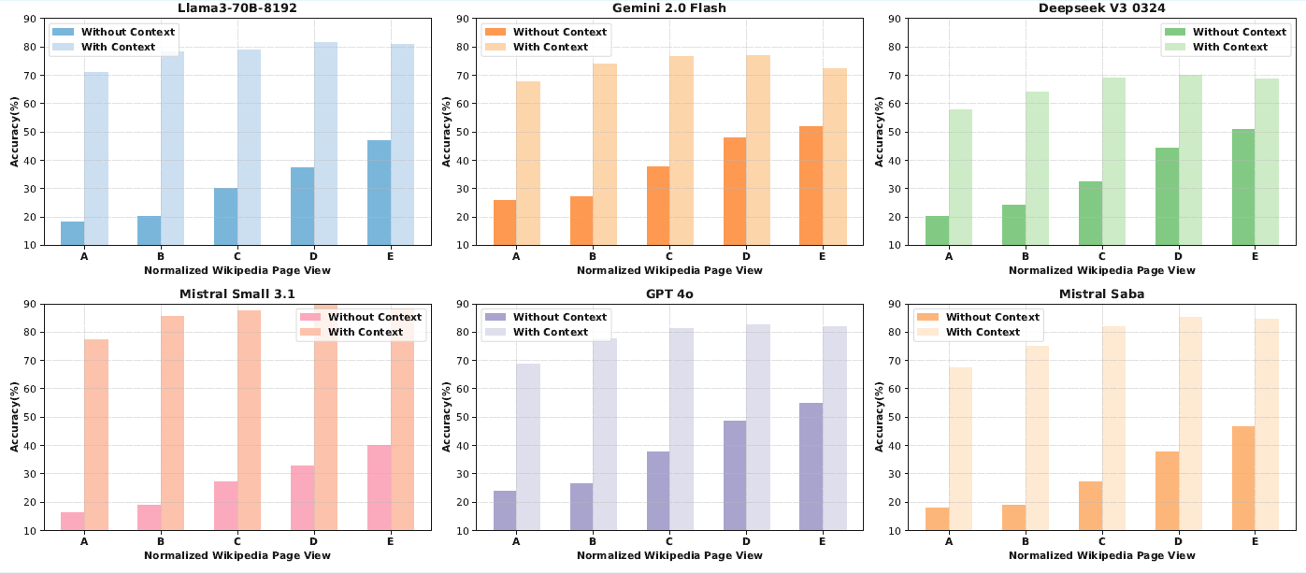
RQ1: Impact of Popularity
The accuracy of the models increases with an increase in term popularity, both with and without context.
This shows that LLMs have better knowledge of more popular terms.

Slide 7
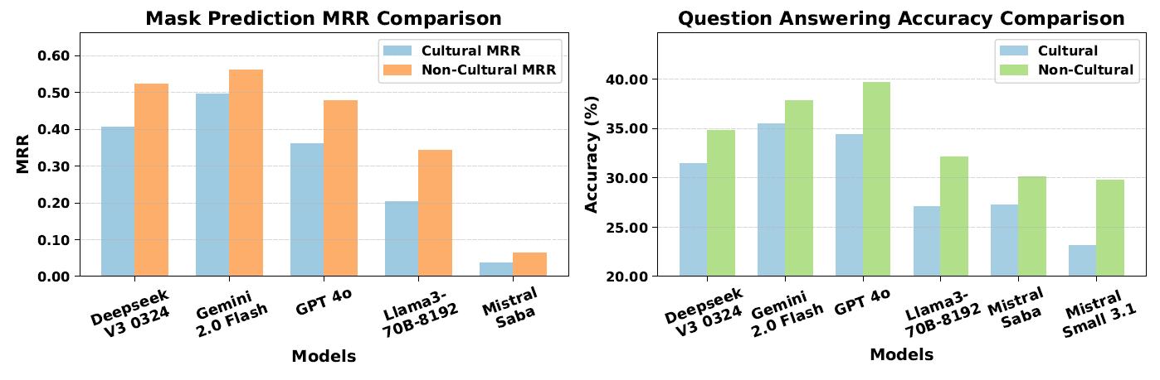
RQ2: Cultural Knowledge Gap in LLM
In both tasks (Question Answering and Masked Prediction), every model has performed better for non-cultural data compared to cultural data, despite dataset having slightly higher number of cultural terms
This indicates a gap in Bengali cultural knowledge
Mistral Saba, although trained on South Asian data, performs worse

Slide 8
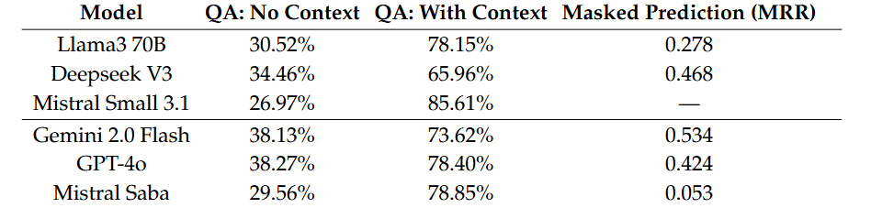
RQ3: Open and Closed-Source LLM
In case of QA with no context, closed models (Mistral Saba) performed better than their open counterparts (Mistral Small 3.1)
Closed-source model outperformed open-source model for both Question Answering and Masked Prediction.
Mistral Small failed to respond consistently to a large number of prompts.

Slide 9
Conclusion
We presented BLanCK dataset which can be used to evaluate any model's Bengali cultural knowledge.
LLMs perform better on Bengali tasks when given context, showing that retrieval is crucial even for well-known terms.
They handle non-cultural topics well but struggle with culturally grounded ones, revealing a clear cultural knowledge gap.
Closed-source models outperform open-source LLMs, suggesting that open models still lack strong Bengali linguistic and cultural understanding.

